Slide 1


Ontology
Matching
Knowledge Graphs Lab 15.07.2019

Slide 2


Our team
Lina Molinas Comet
Tobias Räwer
Jonas Rülfing

Slide 3
Agenda
Motivation
Main concepts (Recap)
Problem Definition
Our Proposal
Methods
Required Steps
Evaluation
Conclusion & Outlook

Slide 4
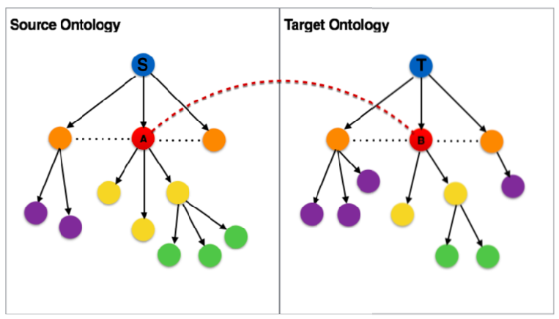
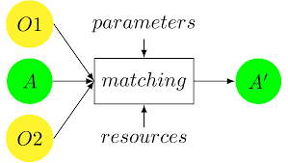
Ontology Matching (Recap)
Ontology matching is the relation between two ontologies where the concepts, roles and restrictions are preserved
Interactive Visualization Of Large Ontology Matching Results (Li & Stroe & Cruz)
Ontology Matching: State of the Art and Future Challenges
(Shvaiko & Euzenat)

Slide 5
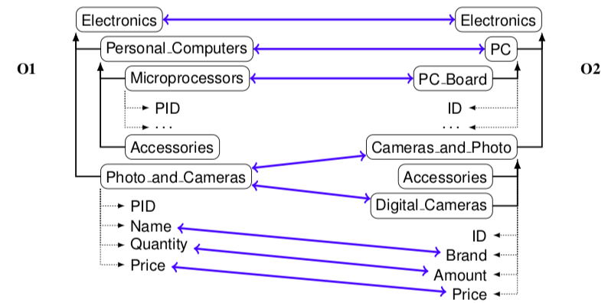
Why do we need Ontology Matching ? (Recap)
Because there is not a unified vocabulary/ontology:
Partially overlap among ontologies
Each ontology represents a own perspective
Different languages
We need Interoperability of
Data and Knowledge
Ten Challenges for Ontology Matching(Shvaiko & Euzenat)

Slide 6
Some problems in Ontology Matching (Recap)
Techniques | Problems
String matching | Too many false positive results (based just on entity name/label)
String matching + logical reasoning | Reasoning highly depend on correctness of the expressions in the ontologies
Blocking (subdividing entities into mutually exclusive blocks) | Unavailability of expertise in every domain Rules are not well specified Not enough training data (supervised learning)

Slide 7
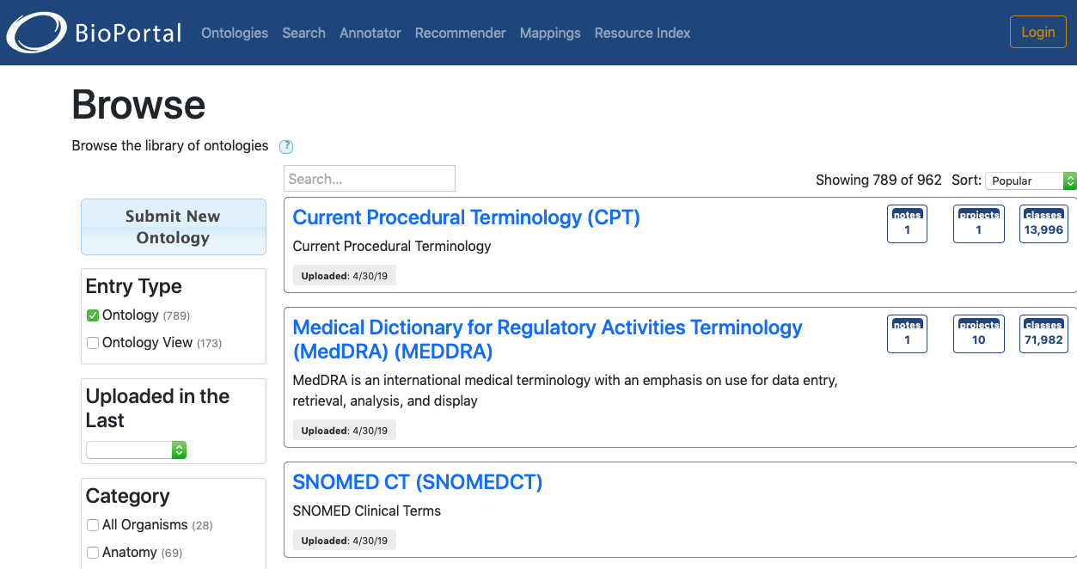
BioPortal
BioPortal is an open repository of biomedical ontologies.
And it provides:
a service to access them
a set of tools to work with them

Slide 8

Ontology Mappings in the BioPortal
Lexical OWL Ontology Matcher (LOOM):
Simple lexical algorithm
Compares preferred names and synonyms of concepts in both ontologies
Manual integrated mappings:
Added by domain experts
Possible by adding through the Web interface or Rest API

Slide 9

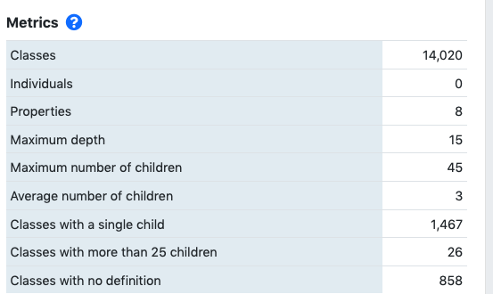
Problem definition
There are not quality measures of the ontology matches among entities in the BioPortal
How do we measure how
suitable are those matches?
Notes:
Bioportal: repository of biomedical ontologies

Slide 10
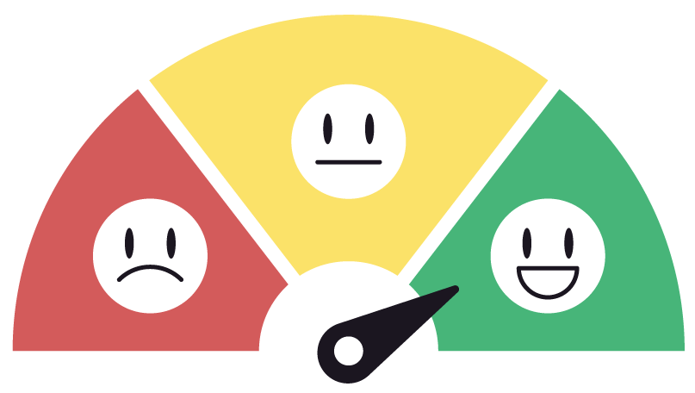
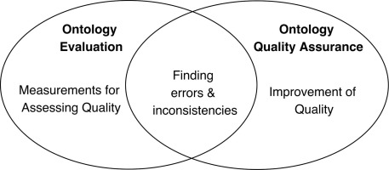
Mappings Evaluation
How good is one matching?
How good is the overall mapping?
Are there loops among the mappings?
Assessing the practice of biomedical ontology evaluation: Gaps and opportunities (Amith et al.)

Slide 11
Our proposal
Terminological Similarity (preferred labels, synonyms, definitions)
Comparison of output results from different metrics
Structural Similarity (Ancestors, Descendants)
Evaluation of existent links between ontologies
Testing our findings (silver standard from Pistoia)
Evaluation of our results
Calculation of Scores

Slide 12

Our steps to reach our goal
Selection of a subset of ontologies
Access data by using the BioPortal REST API
Evaluation of existing mappings
Try out different metrics
Evaluate and refine the used metrics against the Silver Mappings provided from Pistoia

Slide 13
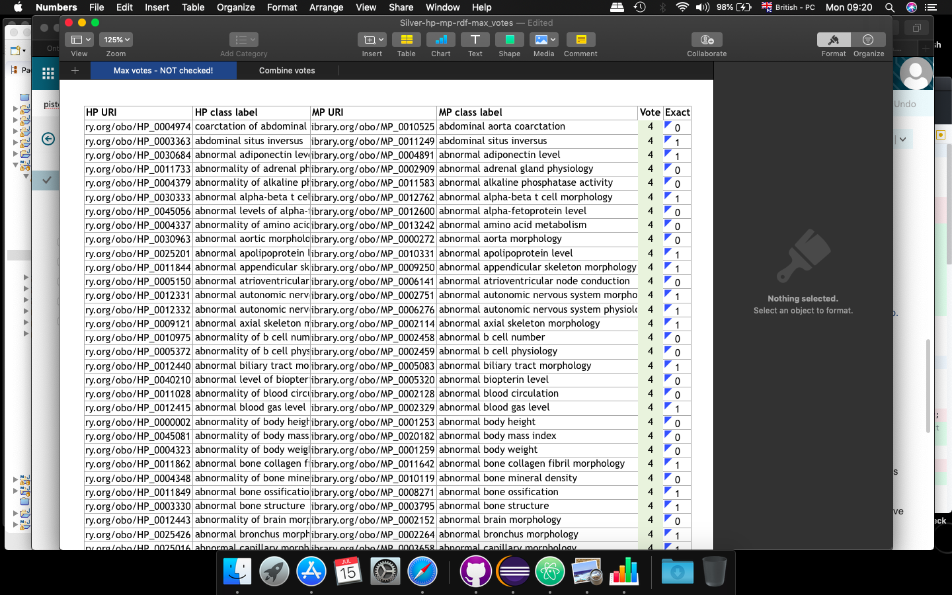
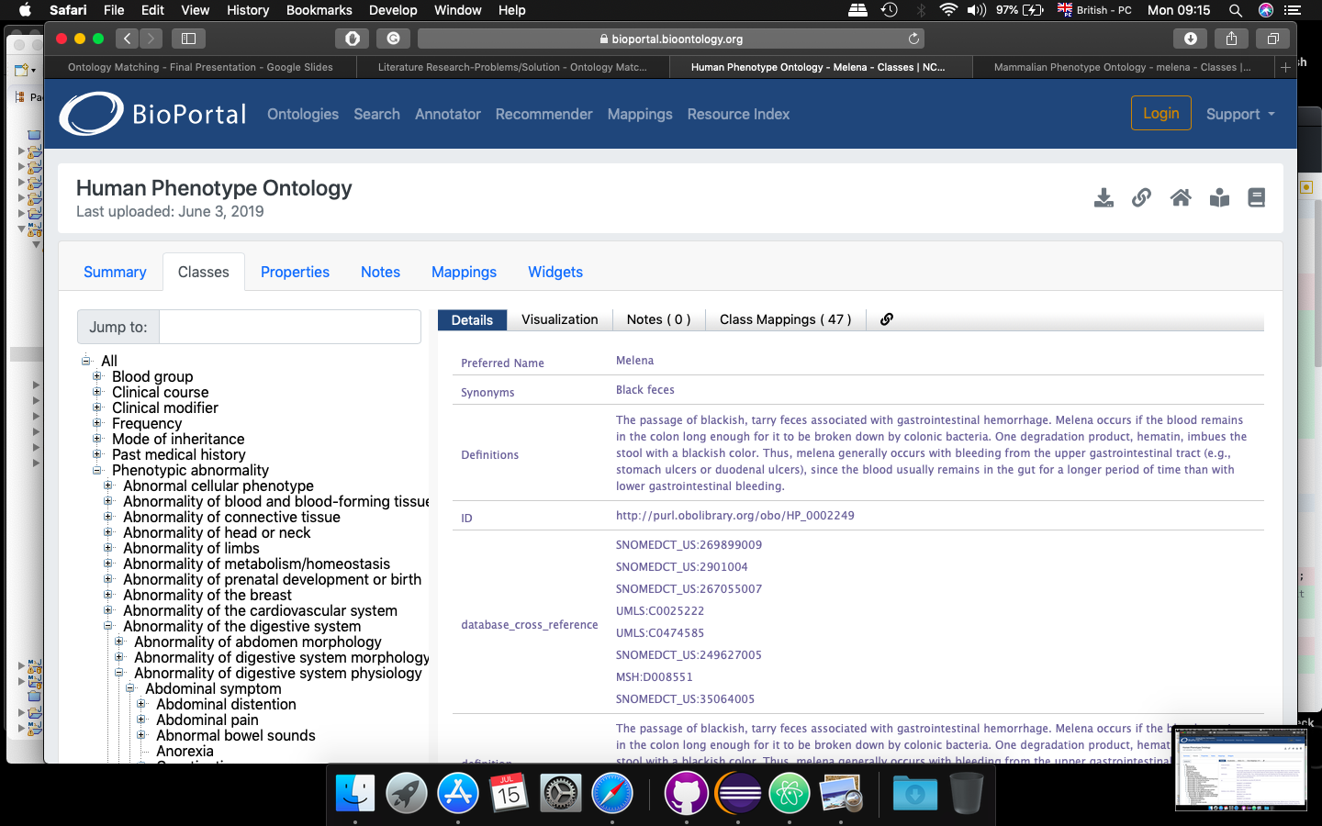
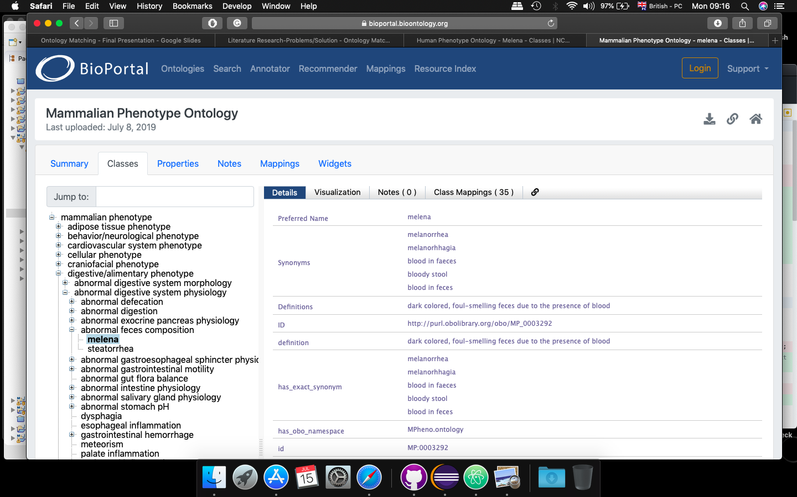

Selected Ontologies

Slide 14
Applied
Metrics

Slide 15
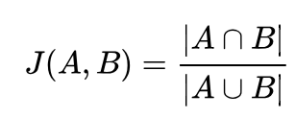
Jaccard Similarity
(Preferred Labels, Definitions, Synonyms)
Property Value
of Ontology A and
Ontology B
A
B
∩
A
B
Jaccard Similarity Value
∪

Slide 16
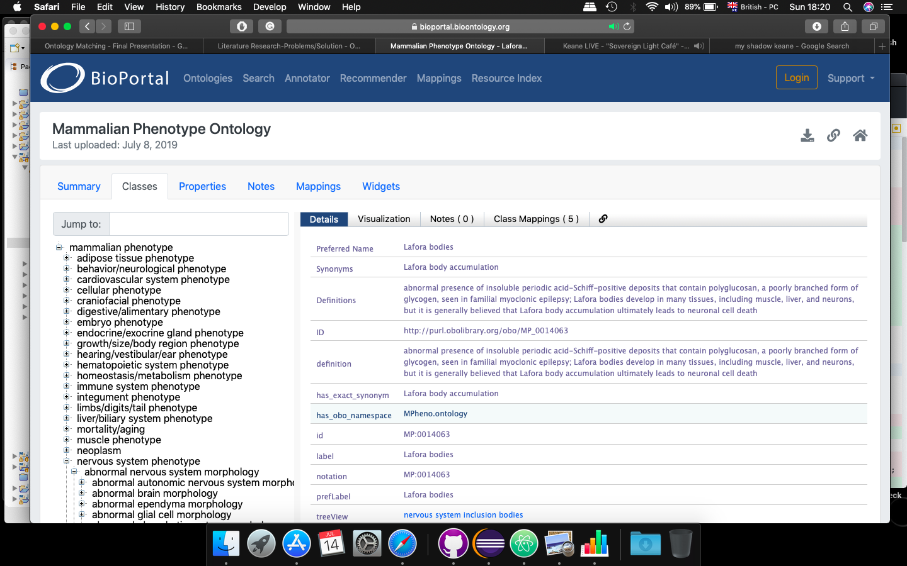

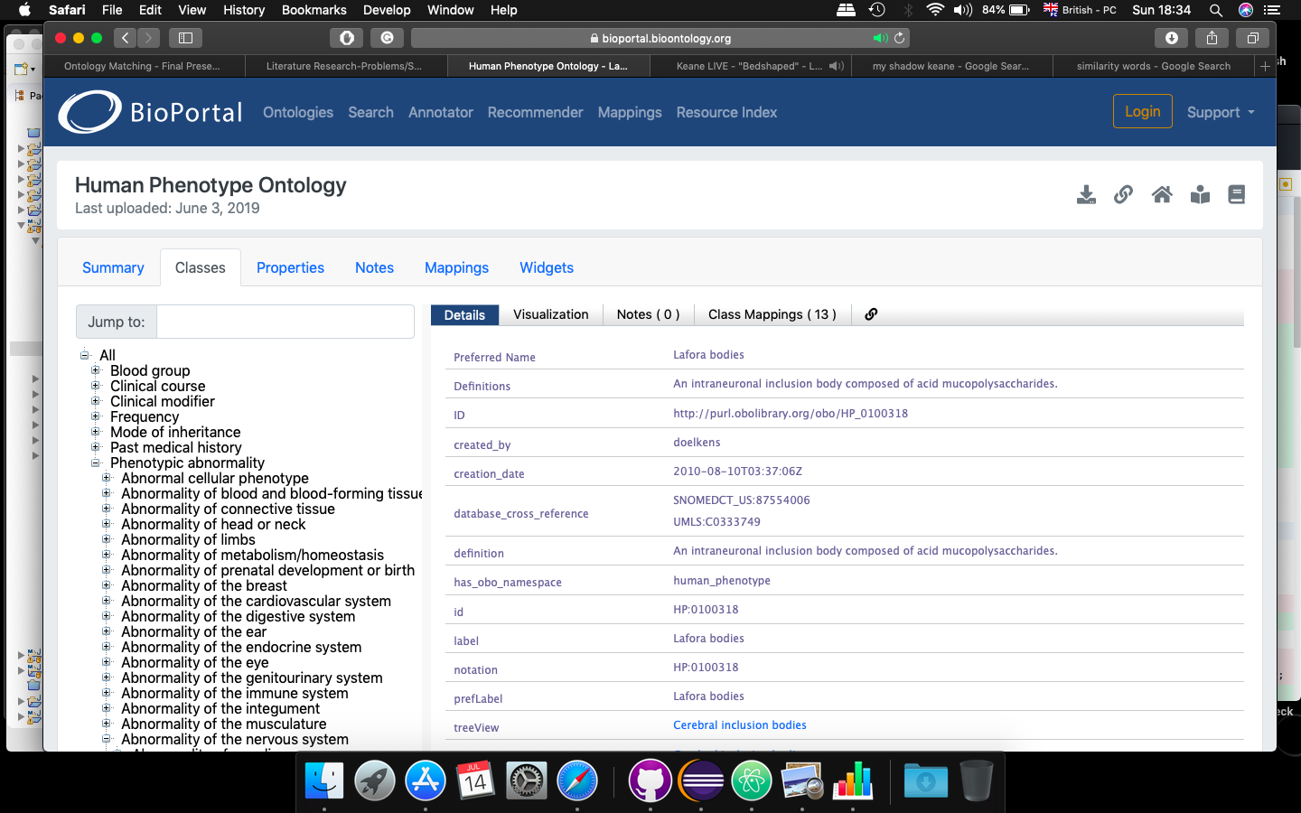
Jaccard Similarity
(Preferred Labels, Definitions, Synonyms)
Jaccard Similarity Value: 1

Slide 17


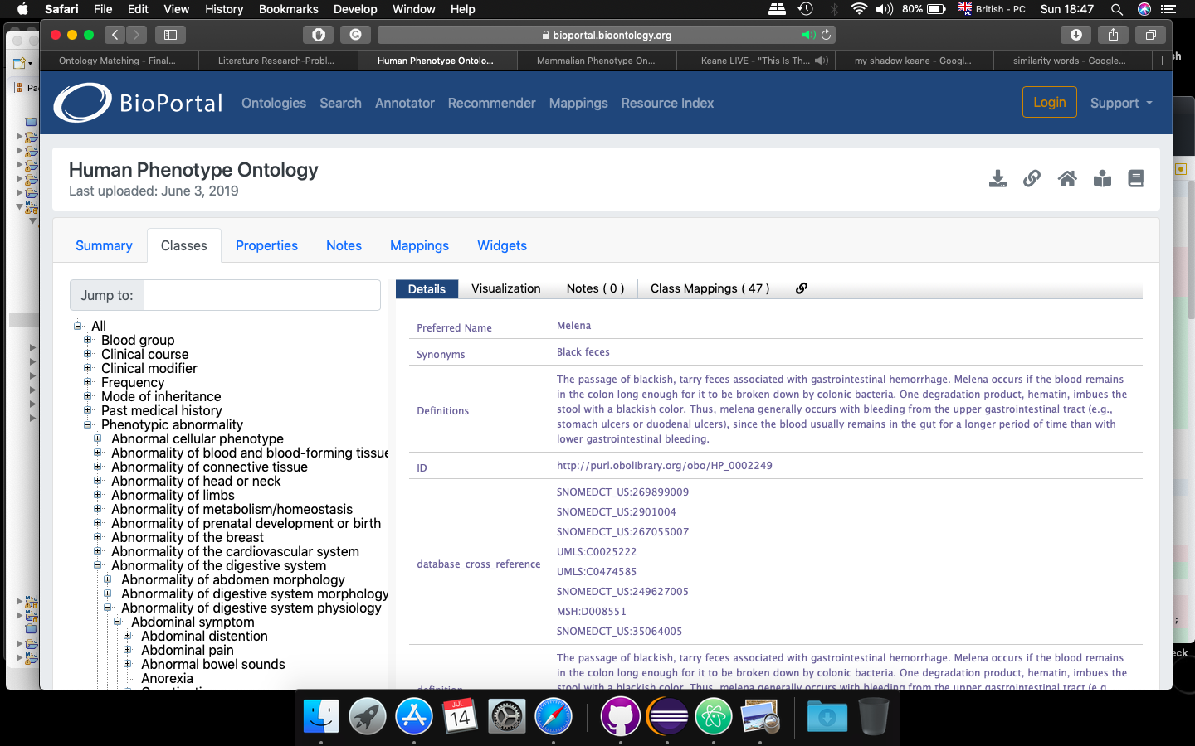
Jaccard Similarity
(Preferred Labels, Definitions, Synonyms)
Jaccard Similarity Value: 0.666

Slide 18
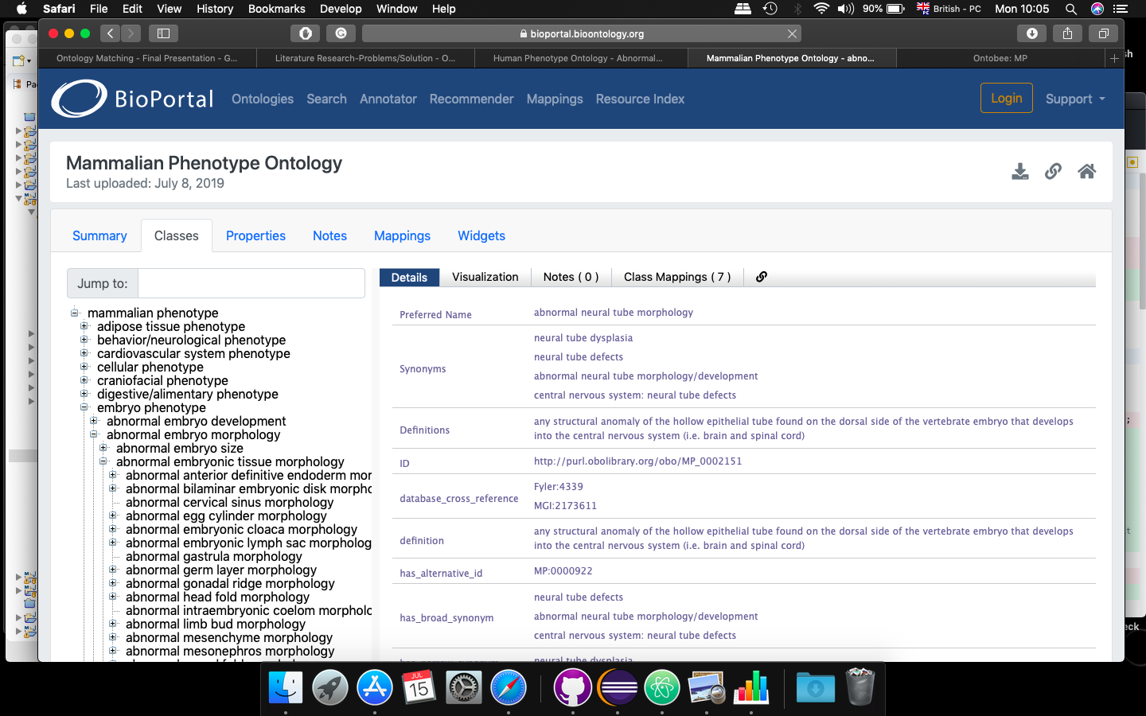
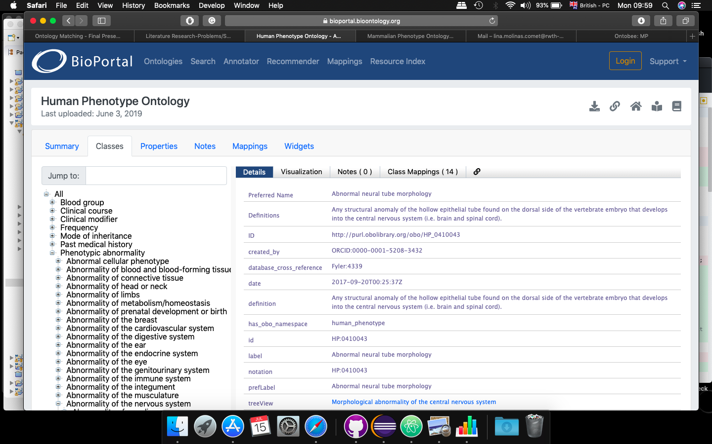
Jaccard Similarity
(Preferred Labels, Definitions, Synonyms)
Jaccard Similarity Value: 0.96

Slide 19
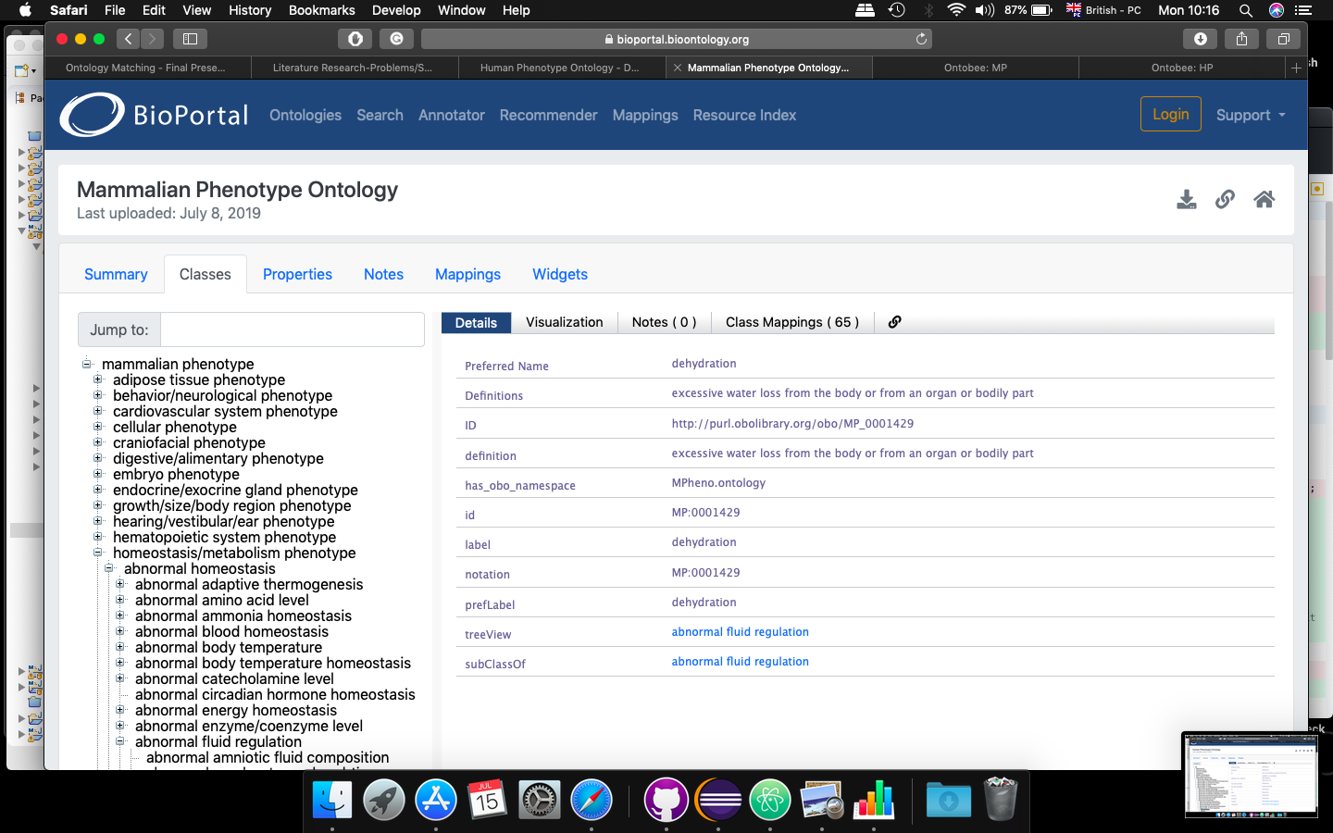
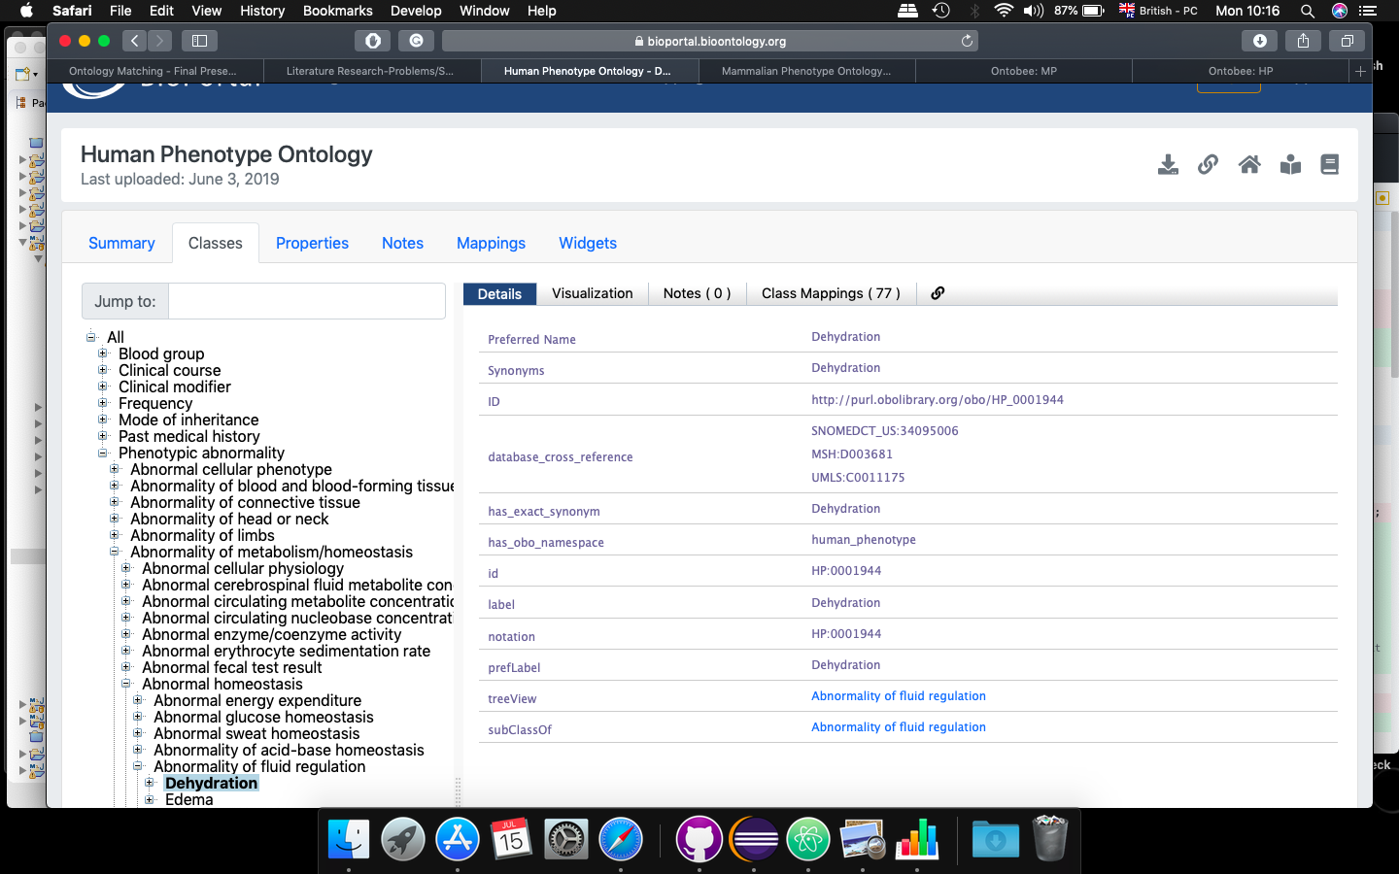

Jaccard Similarity
(Preferred Labels, Definitions, Synonyms)
Jaccard Similarity Value: 0

Slide 20
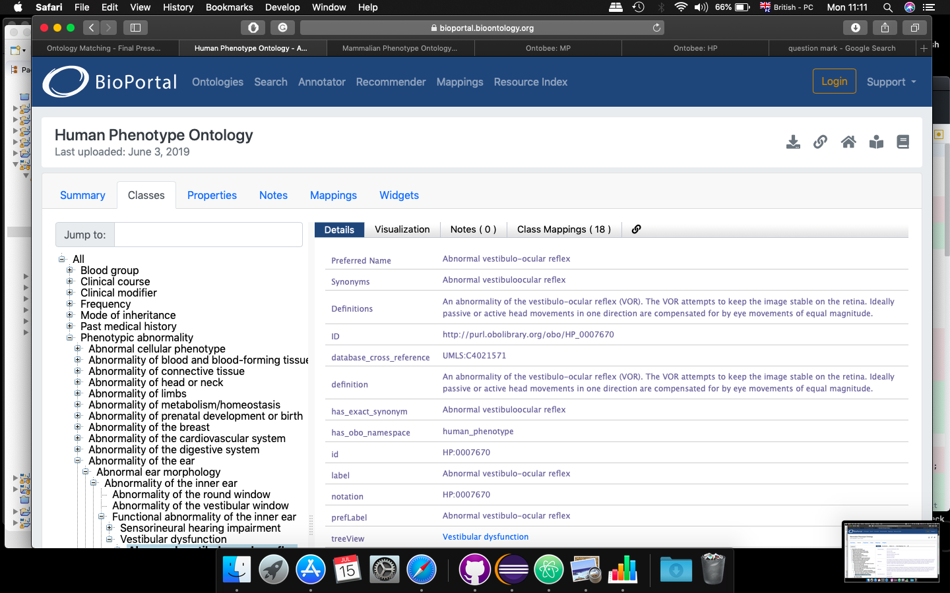
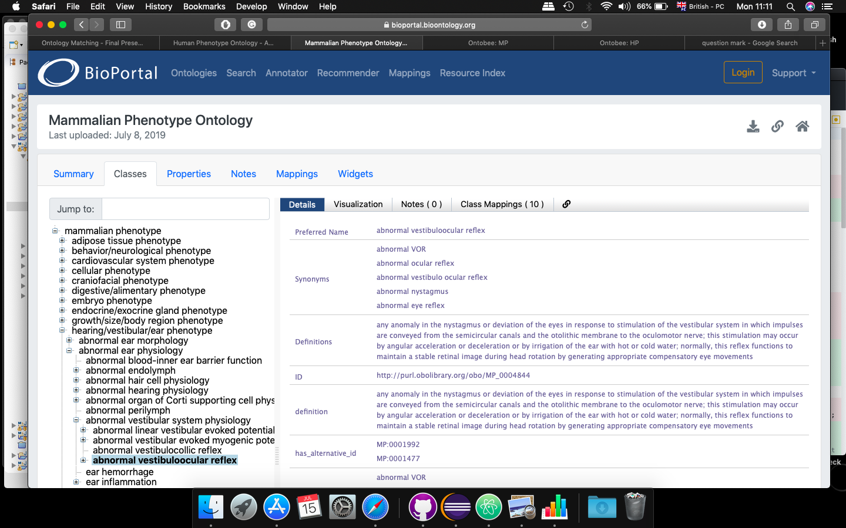
Jaccard Similarity
(Preferred Labels, Definitions, Synonyms)
Jaccard Similarity Value: 0.94

Slide 21
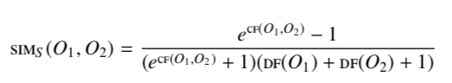
Sigmoid Similarity
(Preferred Labels, Definitions, Synonyms)
Property Value
of Ontology A and
Ontology B
A
B
∩
Union - Intersection
A
B
Sigmoid Similarity Value
∪

Slide 22
Sigmoid Similarity
(Preferred Labels, Definitions, Synonyms)
Sigmoid Similarity Value: 0.99

Slide 23
Sigmoid Similarity
(Preferred Labels, Definitions, Synonyms)
Sigmoid Similarity Value: 0.321

Slide 24
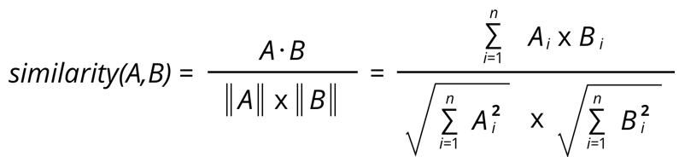
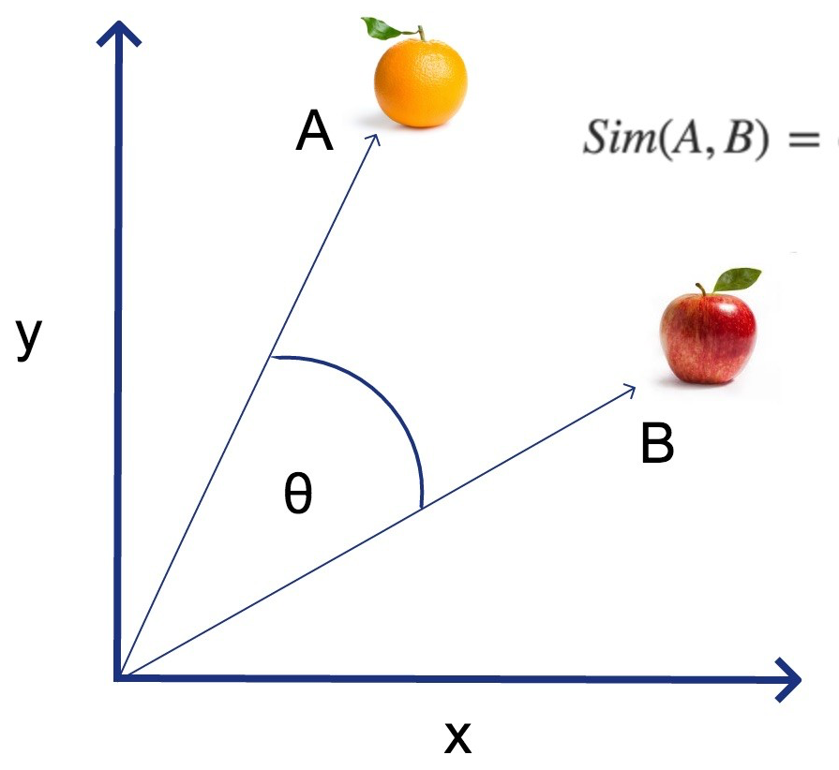
Cosine Similarity
(Preferred Labels, Definitions, Synonyms)
Count frequency of words occurrence (Vector1, Vector2)
Num Similar words, Num Different words
Cosine Similarity Value
Count Number of Different words (Vector1, Vector2)

Slide 25
Cosine Similarity
(Preferred Labels, Definitions, Synonyms)
Cosine Similarity Value: 1

Slide 26
Cosine Similarity
(Preferred Labels, Definitions, Synonyms)
Cosine Similarity Value: 1

Slide 27
Children Metric
Ontology 1
Ontology 2
Mapping 1
A
C
subClassOf
disjoint
Mapping 2
B
D
Logical inconsistent: D should be a subClassOf C, if both ontologies are consistent and mappings are valid

Slide 28
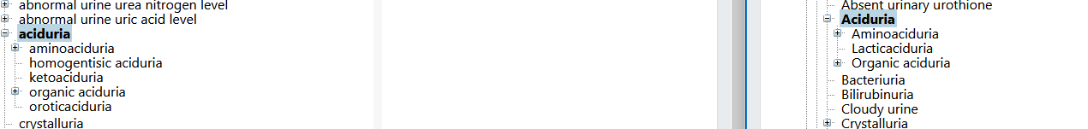
Children Metric
Logical consistent: all subclasses of Aciduria where a mapping exists, are subclasses in both ontologies

Slide 29
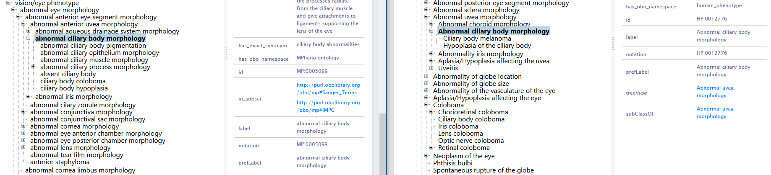
Children Metric
Logical inconsistent: ciliary body coloboma is subclass of abnormal ciliary body morphology in MP, but not in HP

Slide 30
Loop Detection
Ontology A
Ontology B
A U B
A
C
C
B
A
A
C
D
D
B
Notes:
Why is it bad? a new relationship is introduced that doesn’t make sense, e.g. a node cannot be descendant of itself. Therefore, one of the matches has to be wrong (or one of the ontologies)
What is done in literature? In the papers we found, these were the type of loops detected and labelled as critical

Slide 31
Our Loop Detection
A
A

Slide 32
Calculate a Confidence Score after applying Metrics
“Naive” approach
Based on intuitive rules
hasloop?
No
Yes
Children Comparison?
Score = 2
No
Yes
min(jaccardSimilarity, sigmoidSimilarity, cosineSimilarity) < 0.8
min(jaccardSimilarity, sigmoidSimilarity, cosineSimilarity) < 0.8
No
Yes
No
Yes
Score = 4
Score = 3
Score = 3
Score = 2

Slide 33
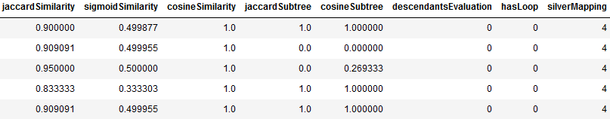
Calculate a Confidence Score after applying Metrics
Machine Learning approaches
Based on logistic regression
Based on random forest
Ground truth provided by silver standard (Pistoia et al.)
Features
Labels
Use 60% of mappings as training set and 40% as test set

Slide 34
Evaluation of
Results

Slide 35
How did we evaluate our results?
Evaluation of mappings between Human Phenotype Ontology (HP) and Mammalian Phenotype Ontology (MP)
Ground truth scores provided by silver standard (Pistoia et al.)
Compare those scores to our scores by naive approach vs machine learning techniques
Test set contains 750 mappings we evaluated
Problem: silver standard from 2017 -> new mappings were created, bad mappings deleted
Only 557 mappings we could compare against silver standard
522 with score 4
7 with score 3
28 with score 2
Notes:
Metrics exist on a syntactic and on a semantic level Metrics can be used either for comparison, or otherwise, application dependent thresholds have to be defined

Slide 36
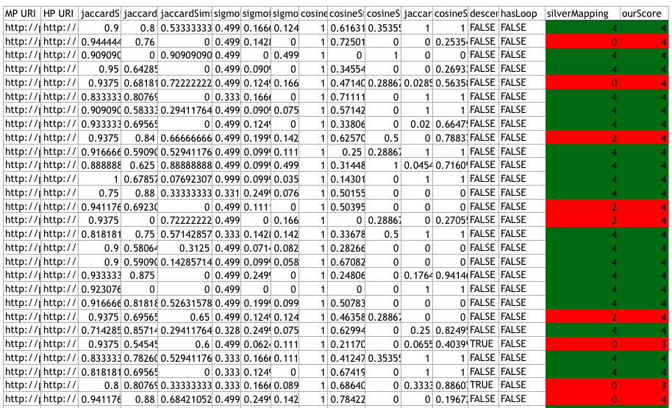

Results from applying metrics
Input for the calculation of score and Machine Learning

Slide 37
Well-known metrics
Metrics | Evaluates
Precision (P_{t}) - Correctness | Number of correctly detected matching pairs Total number of detected pairs
Recall (R_{t}) - Completeness | Number of correctly detected matching pairs Total number of matching pairs given a set of ontology instances
F1-score (F1_{t}) | Aggregation of precision and recall
Notes:
Metrics exist on a syntactic and on a semantic level Metrics can be used either for comparison, or otherwise, application dependent thresholds have to be defined

Slide 38
We evaluated our results based on them
Method | Precision | Recall | F1-measure
Naive | 0.88389 | 0.88509 | 0.88352
Logistic Regression | 0.86165 | 0.92825 | 0.89371
Random Forest | 0.90198 | 0.91479 | 0.90835
Notes:
Metrics exist on a syntactic and on a semantic level Metrics can be used either for comparison, or otherwise, application dependent thresholds have to be defined

Slide 39
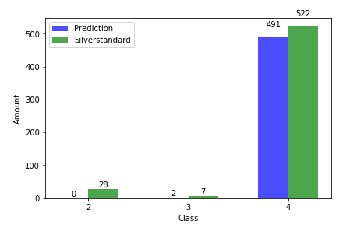
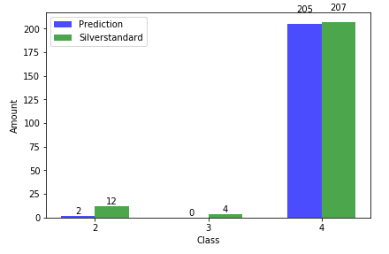
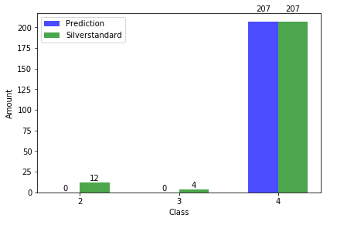
Class specific Results - True Positives
Naive
Random Forest
Logistic Regression
Notes:
Metrics exist on a syntactic and on a semantic level Metrics can be used either for comparison, or otherwise, application dependent thresholds have to be defined

Slide 40
Conclusion &
Outlook

Slide 41

What we have learnt...
Different metrics to assess quality of matchings
Evaluation of results: naive approach vs machine learning techniques

Slide 42
Problems we faced
Big amounts of data
REST API very slow
During Evaluation:
Ground truth was small
hard to apply machine learning
Hard to evaluate quality of links manually, without domain knowledge

Slide 43
Outlook
Extension to more ontologies
→ Ground truth needed
More advanced evaluation of the results
Apply metrics based on semantic

Slide 44
Thanks!
Any questions?

Slide 45
Literature
What is an ontology? - Gruber - 1992
Development 101: a guide to creating your first ontology - Noy, McGuinness - 2001
Ontology instance linking: towards interlinked knowledge graphs - Helfin, Song - 2016
Ten challenges for ontology matching - Shvaiko, Euzenat - 2008
Modulo 5.2 Ontology Matching - Knowledge and Data VU Amsterdam - 2018
A survey on ontology matching techniques - Hooi, Hassan, Shariff - 2014
Measuring Similarity between Ontologies - Maedche, Staab - 2002
Assessing Similarity Value between Two Ontologies - Ngom et al. - 2018
How to Improve Jaccard’s feature-based similarity measure - Likavec et al. - 2018
Where to search top-K biomedical ontologies? - Oliveira et al. - 2018

